Slide 1
Module Title:
MACHINE LEARNING
Module Code:ITLML801
Competence:
MACHINE LEARNING MODULE DESCRIPTION
Learning hours:100
Trainer: Mr. IRABARUTA Emmanuel

Slide 2
OBJECTIVES
This module describes the skills, knowledge and attitude required to develop an apply machine learning.
At the end of this module, the trainee will be able to apply dataset preparation mechanisms, apply machine learning techniques, apply model evaluation techniques.

Slide 3
Apply Data Preparation Mechanisms.
Introduction to machine learning
Setting up machine learning environment
Data Collection and Acquisition
Data Reprocessing

Slide 4
Introduction:
Artificial Intelligence
Machine Learning
Deep learning
Types of Machine Learning Systems,
Main Challenges of Machine Learning.

Slide 5
Statistical Learning:
Introduction:
1.Supervised and Unsupervised Learning
2. Training and Test Loss,
3. Trade-offs in Statistical Learning,
4. Estimating Risk Statistics
5. Sampling distribution of an estimator
6. Empirical Risk Minimization.

Slide 6
Introduction to Machine Learning
Overview
Machine Learning subset of Artificial Intelligence that empowers computers to learn from information, recognize designs, and make choices with negligible human intervention.
It is utilized to mechanize and optimize forms, such as computer vision, natural language processing, and robotics.
Machine Learning algorithms can discover the fundamental structure of information and use this to form forecasts and choices.
This empowers clients to create superior choices, mechanize assignments, and, indeed make totally new items and administrations.

Slide 7
Artificial Intelligence, Machine Learning, Deep learning
1. Artificial Intelligence (AI): In today's world, technology is growing very fast, and we are getting
in touch with different new technologies day by day.
• Here, one of the booming technologies of computer science is Artificial Intelligence which is ready
to create a new revolution in the world by making intelligent machines.
.

Slide 8
• Artificial Intelligence is composed of two words Artificial and Intelligence, where Artificial defines "man-made," and intelligence defines "thinking power", hence AI means "a man-made thinking power."
• So, we can define AI as: "It is a branch of computer science by which we can create intelligent machines which can behave like a human, think like humans, and able to make decisions."
• Artificial Intelligence exists when a machine can have human based skills such as learning, reasoning, and solving problems.

Slide 9
Why Artificial Intelligence?
With the help of AI, you can create such software or devices which can solve real-world problems
very easily and with accuracy such as health issues, marketing, traffic issues, etc.
With the help of AI, you can create your personal virtual Assistant, such as Cortana, Google
Assistant, Siri, etc.
With the help of AI, you can build such Robots which can work in an environment where survival
of humans can be at risk.
AI opens a path for other new technologies, new devices, and new Opportunities

Slide 10
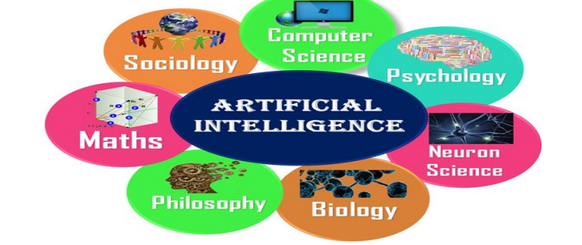

Slide 11
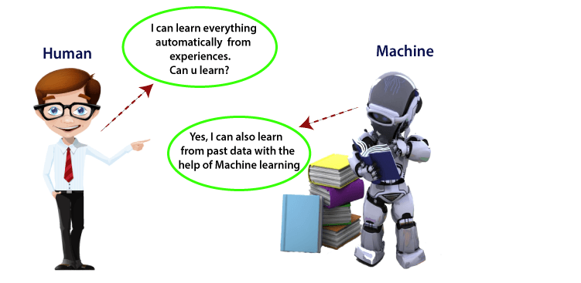

Slide 12
DEFINITION OF MACHINE LEARNING
A subset of artificial intelligence known as machine learning focuses primarily on the creation of algorithms that enable a computer to independently learn from data and previous experiences, Without being explicitly programmed, machine learning enables a machine to automatically learn from data, improve performance from experiences, and predict things.

Slide 13
HOW DOES MACHINE LEARNING WORKS?
Machine learning comes under artificial intelligence that, permits computers to learn from information without being explicitly programmed.
A machine learning system builds prediction models, learns from previous data, and predicts the output of new data whenever it receives it.

Slide 14
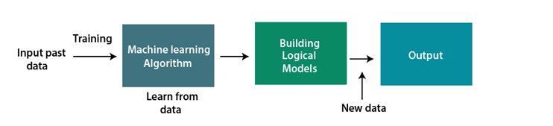
The amount of data helps to build a better model that accurately predicts the output, which in turn affects the accuracy of the predicted output.

Slide 15
MACHINE LEARNING LIFE CYCLE
Machine learning has given the computer systems the abilities to automatically learn without being explicitly programmed. But how does a machine learning system work?
Machine learning life cycle is a cyclic process to build an efficient machine learning project.
Machine learning life cycle involves seven major steps, which are given below:

Slide 16
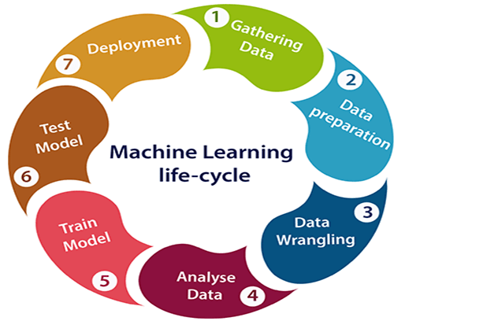
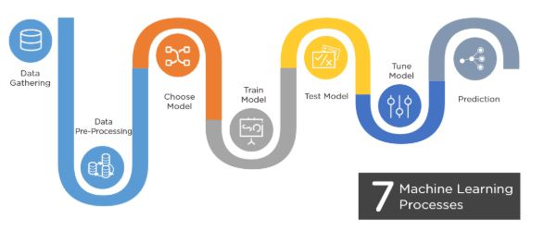

Slide 17
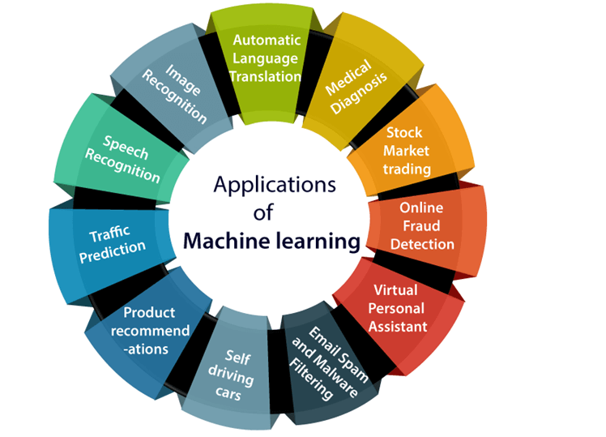
APPLICATIONS OF MACHINE LEARNING
Overview
Machine learning is becoming increasingly popular and is being used in everyday life without us even realizing it.
Some of the most popular real-world applications of machine learning:

Slide 18
Image Recognition: Image recognition is the errand of recognizing objects in digital images. It is a sort of machine-learning strategy that employs a trained model to distinguish objects within an image.
Speech Recognition: Speech recognition is a form of artificial intelligence that enables machines to interpret and act on human speech. It is used to perform tasks such as converting spoken words into text, understanding commands, and performing various other tasks.
Traffic prediction: Traffic prediction is a form of machine learning that includes foreseeing traffic patterns based on chronicled information. This will be utilized to plan traffic routes better, diminish congestion, and improve safety.

Slide 19
4. Product Recommendations: Product recommendation is an machine learning algorithm that employs information to recommend items to clients. It is utilized to personalize shopping encounters and increment sales.
5. Self-driving Cars: Self-driving cars are vehicles that are capable of detecting their environment and navigating without human input. They utilize a combination of machine learning algorithms such as object recognition, path planning, and choice making to independently drive.
6. E-mail Spam and Malware Filtering: Mail spam and malware filtering is a form of machine learning that employs algorithms to distinguish and channel out malicious emails. It is utilized to ensure clients from malicious emails, phishing scams, and other shapes of cybercrime.

Slide 20
7. Virtual Personal Assistant: A virtual personal assistant is a artificial intelligence computer program that's utilized to mechanize assignments such as planning, updates, and other every day errands. It uses a combination of natural language processing and machine learning algorithms to understand user requests and provide helpful reactions.
8. Online Fraud Detection: Online fraud detection is a form of machine learning that uses algorithms to detect and prevent fraudulent activities. It is used to protect users from identity theft, credit card fraud, and other forms of online crime.

Slide 21
9. Stock Market Trading: Stock market trading is a type of machine learning that uses algorithms to analyze and predict stock prices. It is used to make better trading decisions and increase profits.
10. Medical Diagnosis: Medical diagnosis is a form of machine learning that uses algorithms to diagnose diseases. It is used to provide accurate and timely diagnoses to patients.
11. Automatic Language Translation: Automatic language translation is a type of machine learning that uses algorithms to translate text from one language to another. It is used to bridge the language gap and make communication easier.

Slide 22
CONCLUSION
Machine learning is a powerful tool that can be used to automate and improve many different tasks.
It can be used to recognize objects in images, interpret and act on human speech, predict traffic patterns, suggest products to customers, self-drive cars, filter out malicious emails, act as a virtual personal assistant, detect online fraud, trade stocks, diagnose medical conditions, and translate languages.
Machine learning is an ever-evolving technology that is being used to make many tasks easier and more efficient.

Slide 23
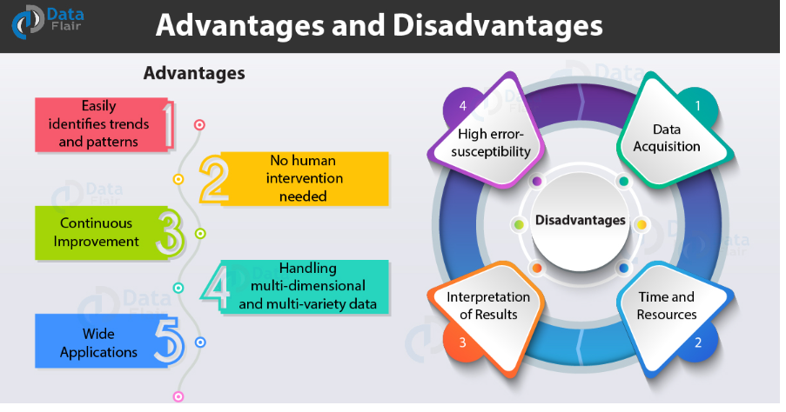
ADVANTAGES AND DISADVANTAGES OF MACHINE LEARNING

Slide 24
1. Easily identifies trends and patterns
Machine Learning can review large volumes of data and discover specific trends and patterns that would not be apparent to humans.
2. No human intervention needed (automation)
With ML, you don’t need to babysit your project every step of the way. Since it means giving machines the ability to learn, it lets them make predictions and also improve the algorithms on their own.
3. Continuous Improvement
As ML algorithms gain experience, they keep improving in accuracy and efficiency. This lets them make better decisions. Say you need to make a weather forecast model.

Slide 25
4. Handling multi-dimensional and multi-variety data
Machine Learning algorithms are good at handling data that are multi-dimensional and multi-variety, and they can do this in dynamic or uncertain environments

Slide 26
DISADVANTAGES OF MACHINE LEARNING
1. Data Acquisition
Machine Learning requires massive data sets to train on, and these should be inclusive/unbiased, and of good quality.
2. Time and Resources
ML needs enough time to let the algorithms learn and develop enough to fulfill their purpose with a considerable amount of accuracy and relevancy. It also needs massive resources to function.
3. Interpretation of Results
Another major challenge is the ability to accurately interpret results generated by the algorithms.
4. High error-susceptibility
Machine Learning is autonomous but highly susceptible to errors. Suppose you train an algorithm with data sets small enough to not be inclusive. You end up with biased predictions coming from a biased training set.

Slide 27
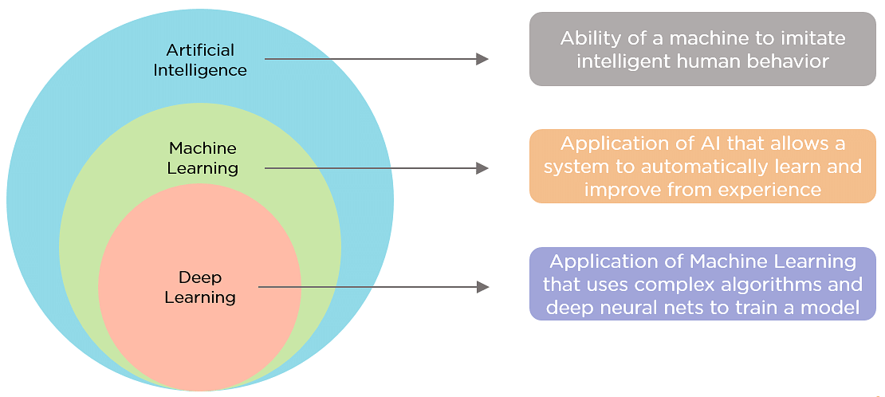
DIFFERENCE BETWEEN MACHINE LEARNING, ARTIFICIAL INTELLIGENCE, AND DEEP LEARNING

Slide 28
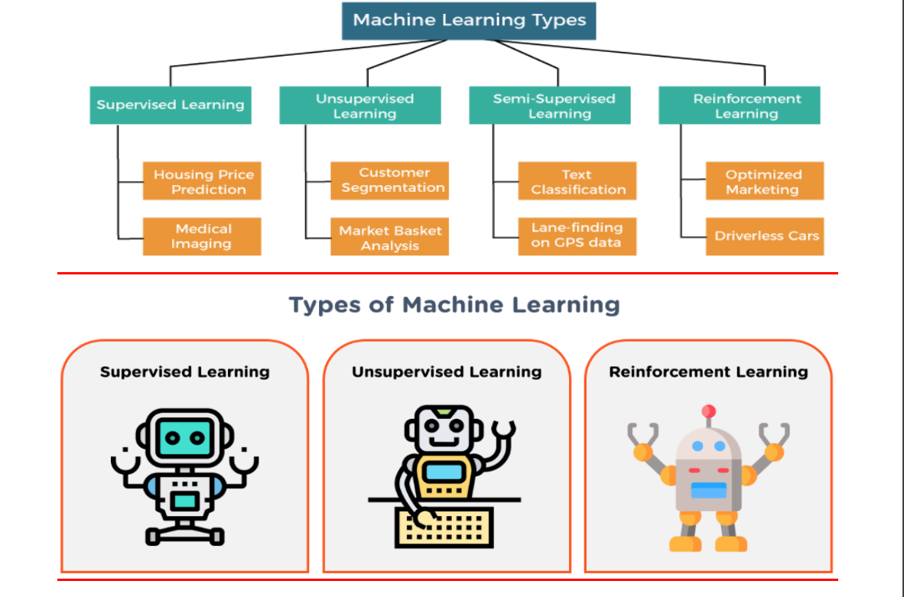
TYPES OF MACHINE LEARNING SYSTEMS

Slide 29
CLASSIFICATION OF MACHINE LEARNING(TYPES OF MACHINE LEARNING)
1. Supervised Learning: Supervised learning is a machine learning algorithm that employs a known dataset to foresee the outcome of new data.
The system uses labeled data to build a model that understands the datasets and learns about each one.
After the training and processing are done,
It means in the supervised learning technique, we train the machines using the "labelled" dataset, and based on the training, the machine predicts the output.
• The main goal of the supervised learning technique is to map the input variable(x) with the output variable(y). Some real-world applications of supervised learning are Risk Assessment, Fraud Detection, Spam filtering, etc.

Slide 30
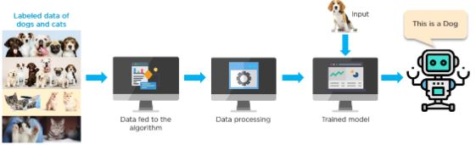
Example of a supervised learning method .
The algorithm is trained using labeled data of dogs and cats.
The trained model predicts whether the new image is that of a cat or a dog.
Some examples of supervised learning include: linear regression, logistic regression, support vector machines, Naive Bayes, and decision tree.

Slide 31
2. Unsupervised Learning: Unsupervised learning is a machine learning algorithm that works with unlabeled data. The objective is to discover structure and designs within the information. Illustrations include clustering, and dimensionality reduction.
The training is provided to the machine with the set of data that has not been labeled, classified, or categorized, and the algorithm needs to act on that data without any supervision.
The goal of unsupervised learning is to restructure the input data into new features or a group of objects with similar patterns.

Slide 32
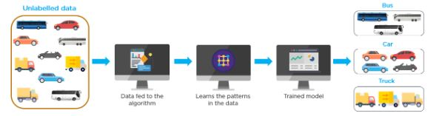
Below is an example of an unsupervised learning method that trains a model using unlabeled data
The purpose of the model is to classify each kind of vehicle.
The machine tries to find useful insights from the huge amount of data. It can be further classifieds into two categories of algorithms : Clustering
Association

Slide 33
3. Reinforcement Learning: Reinforcement learning is a machine learning algorithm that learns from its environment by taking actions and getting rewards for those actions. The objective is to maximize the rewards it gets within the long run.
4. Semi-supervised learning: It is a machine learning algorithm that combines labeled and unlabeled information in order to learn the fundamental structure of the information.
The objective is to use the labeled information to better understand the structure of the unlabeled information.

Slide 34
CONCLUSION
Machine learning has been revolutionizing the insurance industry by giving insurers with the capacity to analyze client information and make tailor-made policies for their clients.
This has helped insurers diminish chance and vulnerability, resulting in higher benefits. Machine learning algorithms have been utilized to better understand client needs and make approaches that are custom-made to those needs.
.

Slide 35
KEY TAKE A WAYS
1. Machine Learning is a type of artificial intelligence that allows software applications to become more accurate in predicting outcomes without being explicitly programmed.
2. Machine Learning algorithms can be classified into supervised, unsupervised, and reinforcement learning algorithms.
3. Supervised learning algorithms use labeled data to make predictions and classifications.

Slide 36
KEY TAKE A WAYS
4. Unsupervised learning algorithms make inferences from data that is not labeled.
5. Reinforcement learning algorithms use rewards and punishments to learn to optimize behavior.
6. Machine Learning is an evolving field of study and requires continuous learning and experimentation to keep up with the latest developments.

Slide 37
TYPES OF MACHINE LEARNING MODEL
Overview
A machine learning model is a mathematical representation of the result of a training process.
This sort of software is outlined to detect patterns or behaviors from the information it is given.
The learning algorithm filters through the information it is given to find patterns, and from this it produces an ML model which can make predictions based on the designs it has found.

Slide 38
TYPES OF MACHINE LEARNING MODELS
Depending on the data set and desired output, algorithms can be placed into different types of ML models. There are three main types of machine learning models as follows:
Supervised Learning:
  Classification
  Regression
Unsupervised Learning:
  Clustering
  Association rule
  Dimensionality reduction
Reinforcement Learning

Slide 39
1. Classification: In machine learning, classification is the process of predicting the class of given data points.
Classification algorithms are used in a wide variety of applications, such as detecting medical conditions, recognizing faces in images, and classifying emails.
It can be used for both supervised learning and unsupervised learning.
Classification: Classification algorithms are used to solve the classification problems in which the output variable is categorical, such as "Yes" or No, Male or Female, Red or Blue, etc.
The classification algorithms predict the categories present in the dataset.

Slide 40
Some popular classification algorithms are given below:
• Random Forest Algorithm
• Decision Tree Algorithm
• Logistic Regression Algorithm
• Support Vector Machine Algorithm

Slide 41
2. Regression: Regression is a statistical method used to model the relationship between a dependent variable and one or more independent variables.
The goal of regression is to find the best-fitting line or curve that describes the relationship between the variables.
Some popular Regression algorithms are given below:
• Simple Linear Regression Algorithm
• Multivariate Regression Algorithm
• Decision Tree Algorithm
• Lasso Regression

Slide 42
ADVANTAGES AND DISADVANTAGES OF SUPERVISED LEARNING:
Advantages:
• Since supervised learning work with the labelled dataset so we can have an exact idea about the
classes of objects.
• These algorithms are helpful in predicting the output on the basis of prior experience.
Disadvantages:
• These algorithms are not able to solve complex tasks.
• It may predict the wrong output if the test data is different from the training data.
• It requires lots of computational time to train the algorithm.

Slide 43
2. UNSUPERVISED MACHINE LEARNING:
• Unsupervised learning is different from the supervised learning technique; as its name suggests, there is no need for supervision.
• It means, in unsupervised machine learning, the machine is trained using the unlabeled dataset, and the machine predicts the output
The main aim of the unsupervised learning algorithm is to group or categories the unsorted dataset according to the similarities, patterns, and differences.
• Machines are instructed to find the hidden patterns from the input dataset

Slide 44
Three tasks which the Unsupervised learning models are mainly used are as follows:
Clustering: Clustering is an unsupervised learning method that groups data into clusters based on similarity and distance measures.
The clustering technique is used when we want to find the inherent groups from the data.
• It is a way to group the objects into a cluster such that the objects with the most similarities remain
in one group and have fewer or no similarities with the objects of other groups.
• An example of the clustering algorithm is grouping the customers by their purchasing behavior.

Slide 45
2. Association Rule Mining: Association rule mining is an unsupervised learning technique that identifies relationships between variables in a dataset.
It is used to identify associations or correlations among variables in a large dataset.
The main aim of this learning algorithm is to find the dependency of one data item on another data item and map those variables accordingly so that it can generate maximum profit.
• Some popular algorithms of Association rule learning are Apriori Algorithm, Eclat, FP-growth algorithm.

Slide 46
Some of the popular clustering algorithms are given below:
• K-Means Clustering algorithm
• Mean-shift algorithm
• DBSCAN Algorithm
• Principal Component Analysis
• Independent Component Analysis

Slide 47
3.DimensionalityReduction:Dimensionality reduction is an unsupervised learning technique that reduces the number of features in a dataset while preserving the important information.
It is used to reduce the complexity of a dataset and make it easier to interpret and analyze.

Slide 48
ADVANTAGES AND DISADVANTAGES OF UNSUPERVISED LEARNING ALGORITHM
Advantages:
• These algorithms can be used for complicated tasks compared to the supervised ones because these algorithms work on the unlabeled dataset.
• Unsupervised algorithms are preferable for various tasks as getting the unlabeled dataset is easier as compared to the labelled dataset.
Disadvantages:
• The output of an unsupervised algorithm can be less accurate as the dataset is not labelled, and algorithms are not trained with the exact output in prior.
• Working with Unsupervised learning is more difficult as it works with the unlabeled dataset that does not map with the output.

Slide 49
REINFORCEMENT LEARNING
Reinforcement Learning is an area of Machine Learning that focuses on how software agents should act in an environment so as to maximize some notion of cumulative reward.
It is based on the idea of learning from rewards and punishments, and from mistakes made by the agent.
In reinforcement learning, there is no labelled data like supervised learning, and agents learn from their experiences only.

Slide 50
An example of reinforcement learning is to play a game, where the Game is the environment, moves of an agent at each step define states, and the goal of the agent is to get a high score.
• Agent receives feedback in terms of punishment and rewards.
• Due to its way of working, reinforcement learning is employed in different fields such as Game theory, Operation Research, Information theory, multi-agent systems.

Slide 51
APPLICATIONS OF DIFFERENT ML MODELS:
Regression:
  Real Estate Prediction
  Weather Forecasting
  Financial Portfolio Prediction
  ETA
Classification:
  Credit card Fraud Detection
  Image Classification
  Spam Detection
  Insurance Decision

Slide 52
Clustering:
  Document theme extraction
  Customer Segmentation
  Insurance Fraud Detection
  Delivery Store Optimization
Reinforcement:
  Traffic Light control
  Resource Management
  Robotics
  Games
  Bidding and Advertisement

Slide 53
CATEGORIES OF REINFORCEMENT LEARNING:
• Reinforcement learning is categorized mainly into two types of methods/algorithms:
• Positive Reinforcement Learning: Positive reinforcement learning specifies increasing the tendency that the required behavior would occur again by adding something. It enhances the strength of the behavior of the agent and positively impacts it.
• Negative Reinforcement Learning: Negative reinforcement learning works exactly opposite to the positive RL. It increases the tendency that the specific behavior would occur again by avoiding the negative condition.

Slide 54
CONCLUSION
Machine Learning Model is a computer program that empowers a framework to learn from information, identify patterns, and make choices with minimal human intervention.
By utilizing supervised, unsupervised, and reinforcement learning procedures, it can produce precise and solid analytics.
This innovation has been utilized in an assortment of businesses, such as healthcare, fund, and retail, to move forward business processes and optimize client encounters.

Slide 55
KEY TAKEAWAYS
1. Supervised Learning:
Focus on making predictions based on labeled data
Use algorithms such as decision trees, support vector machines, and neural networks
Useful for applications such as classification and regression.
2. Unsupervised Learning:
Focus on discovering hidden patterns in unlabeled data
Use algorithms such as clustering and association rule mining
Useful for applications such as data segmentation and anomaly detection

Slide 56
3. Reinforcement Learning:
Focus on maximizing reward from a given environment
Use algorithms such as Q-learning, SARSA, and Deep Q-networks
Useful for applications such as game playing and robotics

Slide 57
KEY TAKEAWAYS
Machine learning is a powerful tool that can be used to automate and improve many different tasks.
It can be used to recognize objects in images, interpret and act on human speech, predict traffic patterns, suggest products to customers, self-drive cars, filter out malicious emails, act as a virtual personal assistant, detect online fraud, trade stocks, diagnose medical conditions, and translate languages.

Slide 58
QUIZ
1. Which of the following explanations is genuine about Machine Learning?
  A. Machine Learning is a type of natural intelligence that empowers computers to learn from information.
  B. Machine Learning is a subset of artificial intelligence that permits computers to learn from information without being explicitly programmed.
  C. Machine Learning is a subset of artificial intelligence that requires explicit programming to learn from information.
  D. Machine Learning is a subset of statistical analysis that helps in choice-making.

Slide 59
2. What is the goal of Supervised Learning?
  A . To find structure and patterns in the data.
  B. To maximize the rewards it receives in the long run.
  C. To learn the underlying structure of the data by combining labeled and unlabeled data.
  D. To learn a model or function that maps the input data to the output labels.
3. Which of the following is an example of Unsupervised Learning?
  A. Support Vector Machines
  B. Decision Trees
  C. Anomaly Detection
  D. Neural Networks

Slide 60
4. Which type of ML model is used to identify patterns and relationships in data?
  A. Regression
  B. Classification
  C. Clustering
  D. All of the Above
5. What is the goal of Reinforcement Learning?
  A. To find structure and patterns in the data.
  B. To maximize the rewards it receives in the long run.
  C. To learn the underlying structure of the data by combining labeled and unlabeled data.
  D. To learn a model or function that maps the input data to the output labels.

Slide 61
6. What type of ML model can be used to identify an outcome based on a set of numerical inputs?
  A. Regression
  B. Classification
  C. Clustering
  D. Decision Tree
7. What is a virtual personal assistant?
  A. A type of artificial intelligence software that automates tasks such as scheduling, reminders, and other daily tasks.
  B. A type of machine learning that analyzes and predicts stock prices.
  C. A type of machine learning that diagnoses medical conditions.
  D. A type of machine learning that translates text from one language to another.

Slide 62
8. What is the use of machine learning in stock market trading?
  A. To automate tasks such as scheduling, reminders, and other daily tasks.
  B. To suggest products to customers based on their purchase history.
  C. To analyze and predict stock prices to make better trading decisions and increase profits.
  D. To diagnose medical conditions accurately and timely.
9. What is the purpose of traffic prediction in machine learning?
  A. To recognize objects in digital images.
  B. To convert spoken words into text and perform various other tasks.
  C. To predict traffic patterns based on historical data to reduce congestion and improve safety.
  D. To detect and prevent fraudulent activities.

Slide 63
10. What is the basic idea of Machine Learning?
  A. To use data to teach a computer program how to perform a specific task.
  B. To use natural intelligence to teach a computer program how to perform a specific task.
  C. To use explicit programming to teach a computer program how to perform a specific task.
  D. To use statistical analysis to teach a computer program how to perform a specific task.

Slide 64
HOME WORK
1. what is Data Collection and Acquisition?
2. Differentiate data, big data and ML dataset?
3. What are main Types of datasets?
4. Identify Source of Dataset?
5. list and explain Key Characteristics for ML dataset?
What are different Types of datasets?

Slide 65
BEST PYTHON LIBRARIES FOR MACHINE LEARNING
in today's world, users can use the Python language, which is the most popular and productive language for machine learning. Python has replaced many languages as it is a vast collection of libraries, and it makes work easier and simpler.
we will discuss the best libraries of Python used for Machine Learning:

Slide 66

NumPy
SciPy
Matplotlib
Pandas
Mglearn
Scikit-Learn,
TensorFlow
Seaborn,
Keras

